Slide 1

The Ohio Confederation Of Teacher Education Organizations
October 9, 2026

Slide 2
Agenda
Race for Ohio Governor
State Legislative Races
Lame Duck
137th General Assembly Outlook
Q&A

Slide 3
GOVERNOR’S RACE
Taxes: What Acton and Ramaswamy have proposed
Amy Acton (D)
Vivek Ramaswamy (R)
Property Tax
Raise the Homestead Exemption income cap to $50,000 (campaign est. +55,000 homeowners). Up to $1,000 rebate when a bill rises more than 4% in a year (household income under $132,000; home ≤ $350,000). Crack down on tax lien certificate sales.
Roll property taxes back to levels “before the end of the pandemic” and cap growth — the “largest property tax cut in America and in Ohio history,” by June 30, 2027. No base year or mechanism identified. New construction not affected; existing debt honored.
Income Tax & Capital Gains Tax
Earned income tax credit. Child tax credit of $1,000 (ages 0–6) and $500 (ages 7–18) for families earning up to $85,000.
“Put Ohio on a path to a zero income tax.” Eliminate the capital gains tax by June 30, 2027.
Data Centers
Conditional moratorium: data centers must cover 100% of utility costs, use union labor, rein in long-term tax incentives, build on previously developed sites, and meet environmental standards.
No property tax abatements for future data centers; 100% of property taxes and energy costs paid, with revenue directed to homeowners in a “benefit zone.” Day-one executive order pausing new approvals.
Notes:
Property tax is the row to dwell on. Whichever candidate wins will likely treat the result as a mandate, and the executive budget is due in March. Ramaswamy originally campaigned on outright elimination of property taxes; the current plan is a rollback plus a growth cap.

Slide 4

GOVERNOR’S RACE
Schools: What each candidate has committed
Amy Acton (D)
Vivek Ramaswamy (R)
School funding Fully fund the Fair School Funding Plan; restore public school funding to “a constitutional level.”
Third Grade Reading Remove the parental-promotion component of the Third Grade Reading Guarantee.
Vouchers Reform the voucher system; says public money should go to public schools.
Math Create an eighth-grade math guarantee.
School meals Free breakfast and lunch for students.
Graduation Require passing a civics assessment to graduate from high school.
Instruction & workforce Invest in “21st century approaches” to math and literacy; create workforce training programs.
Teachers Merit pay for qualifying teachers.
Career-tech Expand career-technical education and apprenticeships.
Health Promote healthy meals and daily physical education.
Stated views, not commitments: Acton is open to a voucher income threshold but has not committed to one. Ramaswamy is generally supportive of vouchers and, on teachers unions, said collective bargaining is “the one area … that I would not rule out eliminating.”
Notes:
This slide lists only things each candidate has explicitly said they would do. Positions that are leanings or “won’t rule out” statements are in the bottom box, labeled as such. Neither candidate has introduced legislation; these are campaign commitments.

Slide 5
THE GENERAL ASSEMBLY
House Democrats need a net gain of six
60
Hollow = the six seats Democrats would need to take, net
votes override a veto — three-fifths of 99.
65 → 59
Six net Democratic gains put Republicans one seat below that line.
2025
Not theoretical: the House came back last year to override DeWine’s property-tax vetoes.
34
65
Democrats
Republicans
Notes:
House today: 65 R, 34 D. Three-fifths of 99 is 59.4, so 60 votes override a veto or pass an emergency clause. A net Democratic gain of six drops Republicans to 59. “Net” matters: every Democratic seat lost must be offset by another flip.
Every House and Senate seat with a cushion under 5% is suburban or small-metro; none are rural (Battlegrounds report).
A Democratic House majority (50 seats, net +16) would require winning a district that leans Republican by nearly 8% — a wave scenario.

Slide 6
THEGENERAL ASSEMBLY
The six thinnest Republican seats
Republican cushion
…AND HOLD THEIR OWN
HD 31
Cuyahoga Falls / Akron · open
Mike Kahoe (R) v. J. Noah Spinner (D)
-0.91%
Democrats’ thinnest seats. Each loss raises the number they must flip.
HD 36
Kettering
Andrea White (R) ★ v. Rose Lounsbury (D), Chuck Horn (I)
-0.71%
HD 10 Grove City
0.40%
HD 35
Twinsburg / Northfield · open
Vik Sandhu (R) v. Samantha Salamon (D)
+0.18%
Mark Sigrist ★ v. Denise D’Angelo
HD 49
Canton
Jim Thomas (R) ★ v. Krista Allison (D)
+0.31%
HD 23 Willowick
0.46%
Daniel Troy ★ v. Julie Belich
HD 52
Elyria / North Ridgeville · open
Cliff Winkel (R) v. Mike Baker (D)
+0.53%
HD 14 Parma
1.20%
HD 60
Powell / Dublin
Brian Lorenz (R) ★ v. Shelby Kimball (D)
+1.27%
Sean Brennan ★ v. David Morgan
HD 53 Avon Lake · open
3.32%
NET +6 LINE
Matt Lundy v. Bradley Lacko
HD 17
Berea / Olmsted Falls
Mike Dovilla (R) ★ v. Megan Coy (D)
+2.20%
HD 15 North Olmsted
3.39%
HD 39
Huber Heights / Dayton · open
Mark Campbell (R) v. DaQuan Neal (D)
+2.64%
Chris Glassburn ★ v. Daniel Conway
Cushion = OMA 2026 Political Republican Index minus 50%, measured for the party holding the seat. ★ incumbent seeking re-election. Source: Ohio 2026 Legislative Battlegrounds (OMA 2026 Election Guide w/ Hannah News, Aug. 2026).
Notes:
Highlighted row: HD 60, Powell/Dublin — Brian Lorenz vs. Shelby Kimball. It is the sixth-thinnest Republican seat on the OMA index and it is in Central Ohio. HD 60 also has one of the widest DeWine-to-Trump splits on the map (11.46 points), so the top of the ticket matters there.
Three of the six are open because Demetriou, Gayle Manning and Plummer left competitive House seats to run for the Senate. HD 64 (Nick Santucci, 3.61%) has no Democratic opponent.
Index note: these cushions use the OMA guide’s Political Republican Index. The separate Vulnerability Rankings (PVI plus incumbency adjustment) orders these seats differently; see my note on methodology.

Slide 7
THE GENERAL ASSEMBLY
The Senate supermajority is not really on the ballot
20 votes to override. Republicans can lose four seats and keep it. Democrats would need 5 of the 11 GOP seats on the ballot.
SD 27
Open · Steve Demetriou (R) v. Mike Roberto (D)
1.56%
SD 13
Open · Gayle Manning (R) v. Joe Miller (D)
3.54%
9 Democrats
24 Republicans
SD 3
Michele Reynolds (R) ★ v. Stacie Baker (D)
4.37%
Democrat, up in 2026 (6)
Democrat, not up (3)
SD 7
Open · Zac Haines (R) v. Cara Jacob (D)
8.51%
Republican, up in 2026 (11)
Republican, not up until 2028 (13)
SD 29
Jane Timken (R) ★ v. Thomas West (D)
8.70%
Hollow seats: the five Democrats would have to flip — with no losses of their own — to push Republicans to 19.
SD 33
Al Cutrona (R) ★ v. Michael Kripchak (D)
9.85%
SD 19
Open · Ryan Rivers (R) v. Scott Charland (D)
10.40%
Only three GOP seats up this year have a cushion under 5%. The fifth flip would be SD 29 — at 8.70%.
Cushion = OMA 2026 Political Republican Index minus 50%, for the holding party. Source: Ohio 2026 Legislative Battlegrounds (Aug. 2026). Only odd-numbered districts are on the 2026 ballot.
Notes:
Senate: 24 R, 9 D. Only the 17 odd-numbered districts are up (11 R-held, 6 D-held). Twenty votes override a veto (three-fifths of 33 = 19.8). Republicans can lose four and keep 20; Democrats need five flips while holding all six of their own — and no Democratic seat up this year has a cushion under 12%.
Central Ohio: SD 3 (Canal Winchester/Reynoldsburg) is the only competitive GOP Senate seat with an incumbent running. SD 19 is Sen. Brenner’s open seat.
Note: the Battlegrounds PDF discusses a 22-seat “two-thirds” line; Ohio’s veto override is three-fifths, so 20 is the number here.

Slide 8
Acton leads in 6 of the 7 Ohio polls since Sept. 1
Margin in each public poll, Amy Acton (D) vs. Vivek Ramaswamy (R), April 2025 – October 2026
SINCE SEPT. 1
▲ Acton ahead
RCP POLLING AVERAGE
Polls fielded Sept. 1 – Oct. 5
Acton (D)
48.9%
Ramaswamy (R)
44.1%
▼ Ramaswamy ahead
Acton +4.8
Source: RealClearPolitics, “2026 Ohio Governor – Ramaswamy vs. Acton” poll table (as of Oct. 8, 2026)
Notes:
Poll data (RealClearPolitics), oldest to newest — Acton / Ramaswamy, spread:
Bowling Green/YouGov 4/18–4/24/25, 800 RV: 45/50, R+5
Emerson 8/18–8/19/25, 1000 RV: 39/49, R+10
Bowling Green/YouGov 10/2–10/14/25, 800 RV: 47/50, R+3
Emerson 12/6–12/8/25, 850 RV: 46/45, A+1
Quantus Insights 3/13–3/14/26, 809 RV: 46/45, A+1
Bowling Green/YouGov 4/7–4/14/26, 1000 RV: 47/48, R+1
FOX News 5/28–6/1/26, 1105 RV: 50/49, A+1
Fabrizio/Anzalone 6/14–6/16/26, 800 LV: 47/44, A+3
NY Times/Siena 6/15–6/28/26, 601 LV: 47/47, Tie
FOX News 8/6–8/10/26, 1008 RV: 48/50, R+2
Bowling Green/YouGov* 9/1–9/10/26, 1000 LV: 48/45, A+3
Big Data Poll* 9/25–9/27/26, 680 LV: 47/48, R+1
Marist 9/24–9/27/26, 1298 RV: 50/44, A+6
USA Today/Suffolk* 9/23–9/27/26, 500 LV: 50/41, A+9
YouGov 9/18–9/30/26, 3777 LV: 48/44, A+4
NY Times/Siena 9/22–10/1/26, 616 LV: 49/45, A+4
CNN 9/29–10/5/26, 760 LV: 50/42, A+8
RCP Average 9/1–10/5: Acton 48.9, Ramaswamy 44.1, Acton +4.8
(* = marked with an asterisk on RCP. Years for 2025 polls inferred from RCP's newest-first ordering.)

Slide 9
In 2018, Cordray led 3 of 4 fall polls — DeWine won by 4.3
Margin in each poll, Richard Cordray (D) vs. Mike DeWine (R), March – October 2018, and the final result
SINCE SEPT. 1
RESULT
▲ Cordray ahead
POLLS SINCE SEPT. 1
Simple average of 4 polls*
Cordray (D) led by
+3.5
FINAL RESULT
DeWine (R) 50.7%
Cordray (D) 46.4%
DeWine +4.3
▼ DeWine ahead
7.8-point gap between the fall-poll average and the result
Source: RealClearPolitics, “2018 Ohio Governor – DeWine vs. Cordray” poll table and final results.
Notes:
Poll data (RealClearPolitics), oldest to newest — DeWine / Cordray, spread:
WOIO-TV/SurveyUSA 3/16–3/20/18, 1408 RV: 47/39, DeWine +8
Suffolk 6/6–6/11/18, 500 LV: 36/43, Cordray +7
Quinnipiac 6/7–6/12/18, 1082 RV: 40/42, Cordray +2
NBC News/Marist 6/17–6/21/18, 778 RV: 46/42, DeWine +4
NBC News/Marist 9/16–9/20/18, 564 LV: 47/47, Tie
Suffolk* 10/4–10/8/18, 500 LV: 40/46, Cordray +6
Emerson 10/26–10/28/18, 566 LV: 46/49, Cordray +3
Gravis 10/29–10/30/18, 789 LV: 43/48, Cordray +5
Final Results: DeWine 50.7, Cordray 46.4, DeWine +4.3
Simple average of the 4 post-Sept. 1 polls: (5 + 3 + 6 + 0) / 4 = Cordray +3.5 (our calculation; RCP's final average is not shown in the source screenshot). Gap to result: 3.5 + 4.3 = 7.8 points.
(* = marked with an asterisk on RCP.)

Slide 10

Lame Duck

Slide 11
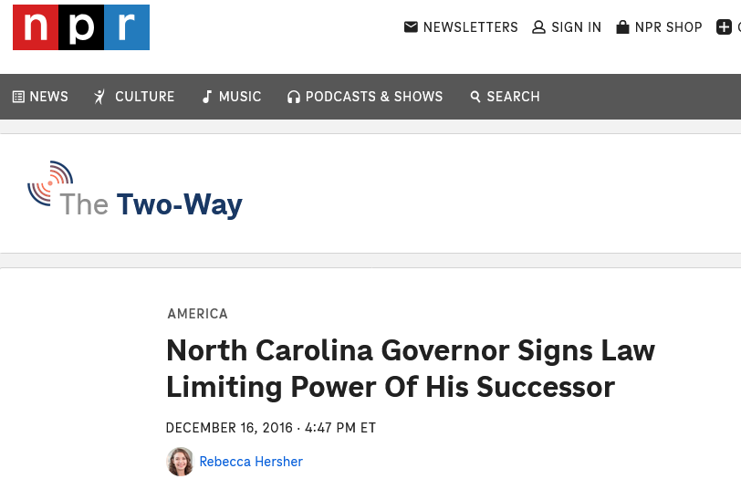
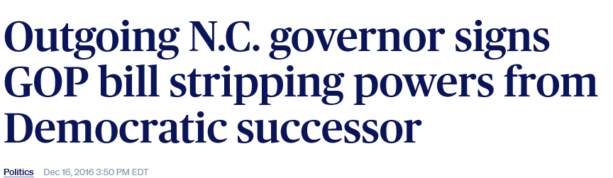
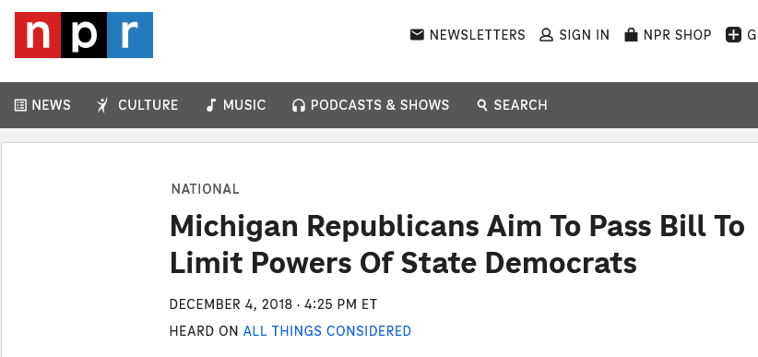
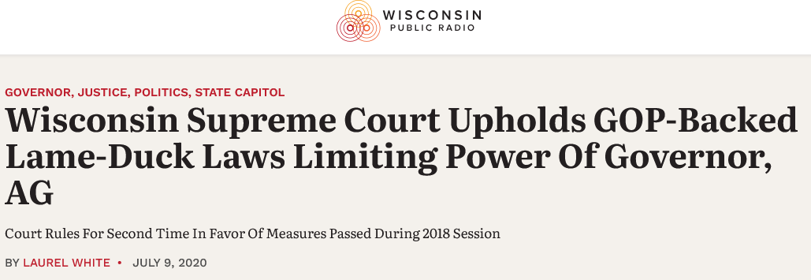
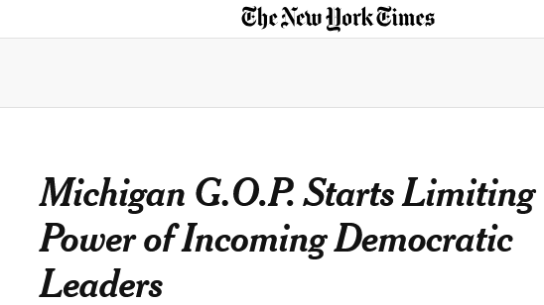
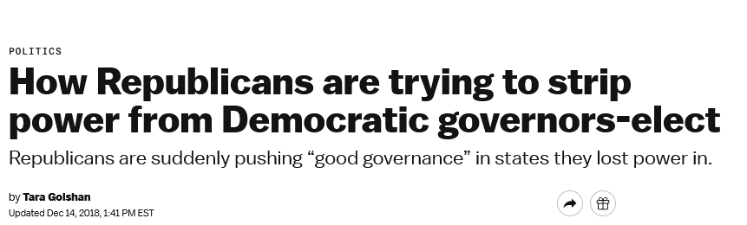
Lame Duck

Slide 12
House Bill 523
Future Educators Support Act
  Sponsored by Reps. Sean Brennan (D-Parma) and Gayle Manning (R-North Ridgeville)
  Passed House by a vote of 91-0 on June 3, 2026
  Awaiting a first hearing in the Senate Higher Education Committee
  Authorizes school districts, ESCs, charter schools, and STEM schools to pay student teachers a stipend
  Authorizes public colleges and universities to provide reduced tuition and to waive fees for student teachers
  Creates a list of in-demand teaching jobs in Ohio

Slide 13
Senate Bill 144
Grade Band Licensure
  Sponsored by Sen. Catherine Ingram (D-Cincinnati)
  Passed Senate by a vote of 32-0 on October 29, 2025
  Awaiting a second hearing in the House Education Committee; most recent hearing was on March 3, 2026
  Revises grade band licensure to become preK-5, 4-8, and 7-12
  Requires issuance of preK-5 licenses in general education instruction or both general and special education instruction
  Requires issuance of 4-8 licenses in general education instruction
  Prohibits first-year teachers from being employed outside their grade band

Slide 14
Senate Bill 328
Career Awareness Instruction
  Sponsored by Sen. Kyle Koehler (R-Springfield)
  Passed Senate by a vote of 30-0 on May 20, 2026
  Awaiting a third hearing in the House Education Committee; most recent hearing was on June 8, 2026
Requires sixth-graders to complete a career and academic plan by the end of eighth grade
Requires public schools to offer at least 60 hours in the study of career exploration to students in grades six to eight
Requires public schools to develop graduation and career plans or graduation planning addenda to existing career and academic plans for at-risk students

Slide 15
Senate Bill 461
Strengthening Ohio Civics Act
  Sponsored by Sen. Jerry Cirino (R-Kirtland)
  Introduced on June 22, 2026; awaiting a first hearing in the Senate Higher Education Committee
  Expands the authority and independence of the state’s five state Civics Centers, giving their directors broad control over hiring, tenure, curriculum, funding, course revenues, and the newly required American Civic Literacy course
    Cleveland State University, Miami University, Ohio State University, University of Toledo, and Wright State University

Slide 16
House Bill 698
S.B. 1 Compliance Supplemental Appropriation Act
  Sponsored by Rep. Tom Young (R-Washington Township)
  Awaiting a fourth hearing in the House Workforce and Higher Education Committee; last hearing was on May 19, 2026
  Requires public colleges and universities to annually certify compliance with laws related to Senate Bill 1
  Requires presidents and board chairs to sign certain certifications and reports, expands state expenditure transparency provisions to include state institution salary and employment information, and creates reporting requirements related to employees who previously performed diversity, equity, and inclusion functions and were reassigned

Slide 17
Senate Bill 311
Education Omnibus Bill
  Sponsored by Sen. Andrew Brenner (R-Delaware)
  Passed Senate by a vote of 24-9 on June 10, 2026
  Awaiting a first hearing in the House Education Committee
  Exempts certain out-of-state educator license applicants from reading coursework requirements if they passed Ohio’s Foundations of reading exam on the first attempt

Slide 18
137th General Assembly
Potential Leadership and Committee Chairs
  House Speaker Matt Huffman (R) – current speaker
  Senate President Bill Reineke (R) – expected president
  Senate Education Committee - ?????
  House Education Committee – Rep. Sarah Fowler Arthur (R)
  Senate Higher Education Committee – Sen. Jane Timken (R)
  House Workforce and Higher Education Committee – Rep. Tom Young (R)
  Potential for change based on gubernatorial election
    Chancellor of the Department of Higher Education – Mike Duffey
    Director of the Department of Education and Workforce – Steve Dackin
*

Slide 19
137th General Assembly
Biennial Budget Process
  March 15, 2027 – Budget submission deadline
  March – April – House budget hearings
  April 2027 – House budget is unveiled and passed
  April – June – Senate budget hearings
  June 2027 – Senate budget unveiled
  Mid-June 2027 – Conference Committee report unveiled
  June 30, 2027 – Deadline for bill to be signed
*

Slide 20
137th General Assembly
Policy Topics
  Data Centers
  Property Tax Reform
  Science of Reading
  Math Instruction
  School Funding
  Income Tax and Capital Gains Tax
  Medicaid
  Senate Bill 1 Compliance and Civics Center Reform
*

Slide 21
Contact us!
Will Schwartz, Pappas and Associates
wschwartz@pappaskc.com
614-621-2000

